Slide 1
Power Hour Game Time
Kristyna Ferris
She/Her
Solution Architect
P3 Adaptive

Slide 2
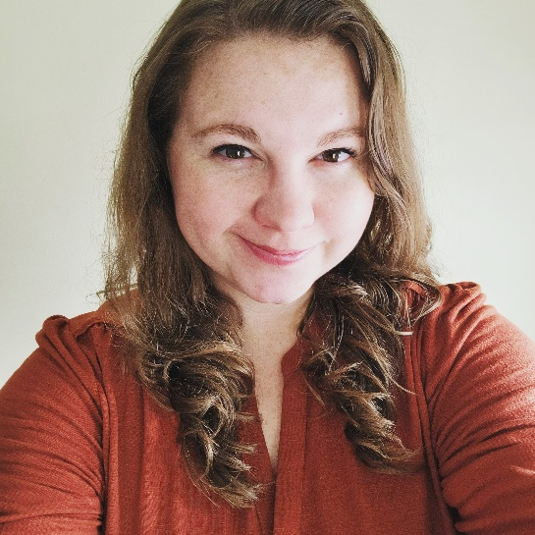


Kristyna
Ferris
she/her
Solution Architect
P3 Adaptive
Microsoft MVP, Data Platform & Fabric
Solution Architect, P3 Adaptive
Lexington Data Tech Group co-organizer
Co-author on DataOnWheels
Co-founder of Data On Rails
@data_dragoness
https://www.linkedin.com/in/kristyna-ferris-dataonwheels/
https://dataonwheels.wordpress.com/
Notes:
Peter

Slide 3


Sound Familiar?
Meetings that could have been an email
Reports that are basically excel sheets
Reports that aren’t used after months of work
Company wide meetings

Slide 4

There’s a better way!

